Slide 1
OVERVIEW OF A RESEARCH ARTICLE
1.Title

Slide 2
2. Author’s name: Benter Oseno Gudu
Affiliation: Moi University, PO box3900– 30100,
Eldoret, Kenya

Slide 3
3.Abstract
Topic: This study sought to find out the classroom activities used by teachers to promote learners’ active participation in speaking skills lessons in eight secondary schools in Eldoret Municipality, Kenya.
Purpose: There is a general public concern in Kenya that majority of Form Four school leavers lack communicative and linguistic competence and thus cannot sustain conversation in English language without occasionally code switching to Sheng or Kiswahili.
Method: The study adopted mixed methods design and simple random sampling to select schools, students and English language teachers from National, Provincial and District schools. In certain cases, purposive sampling technique was also used. Data on classroom activities used to teach speaking skills were collected using Questionnaires administered to teachers and students, direct observation during speaking skills lessons in Form three classrooms. The data collected was analyzed using descriptive statistics.
Results: The study found out that there was variation in use of classroom activities for example discussion was the most used classroom activity while oral drill was the least used, during classroom discussions, students code switched to Kiswahili or Sheng due to low oral skills and teachers did not integrate various classroom activities in one lesson thus denied learners chances of using authentic language in context.
Conclusions: The study recommends that: 1) students should be given chances to practice using authentic English language in context, 2) teachers should integrate various activities in a lesson to meet learners’ needs and 3) Curriculum to acknowledge learners’ cultural backgrounds in order to enhance their learning outcomes. This study is useful to language educators and teachers of English language.
Keywords: speaking skills, classroom activities, English, language, motivation, teacher, learner

Slide 4
4.INTRODUCTION
I. Background information:
The author has shown that the importance of one attaining communicative competence in English language in Kenyan Education system cannot be overemphasized by presenting the past research. Some factors that influence learning of speaking skills.
The author want to accomplish that find out problem of poor spoken English language as a result of various reasons advanced by scholars such as: lack of assessment of speaking skills, students have no motivation to express themselves and others
The author want to accomplish that find out problem of poor spoken English language as a result of various reasons advanced by scholars such as: lack of assessment of speaking skills, students have no motivation to express themselves and others
The objective and method related are also mentioned. according to English language scholars, use of learner-centered classroom activities including group discussions, speeches, storytelling, drama, debates, poem recitation, songs, and tongue-twisters could alleviate the problem of low oral skills

Slide 5
4.INTRODUCTION
II.Research question:
This study therefore sought to establish classroom activities employed and how they are used by teachers in form three English lessons to enhance learners’ active participation in secondary schools.
III. objective:
Majority of Form Four school leavers lack communicative and linguistic competence and thus cannot sustain conversation in English language without occasionally code switching to Sheng or Kiswahili.

Slide 6
5.METHODS
Context: The study was carried out in Eldoret Municipality which has three districts, namely Eldoret East, Wareng, and Uasin Gishu West, Uasin Gishu County, Kenya. The municipality was selected for this study because it experiences problem of low communicative competence of Form four graduates like other parts of Kenya.
Methodology:
The sapling procedure: A table of random numbers was employed to sample the Provincial and District secondary schools except national school category where there was only one in the entire Municipality thus purposively sampled.
The participants: A total of eight out of twenty three secondary schools, constituting about 30 % of sampled population of secondary schools in the Municipality were selected. The same technique was again used to select 30% of form three students per school. Purposive sampling was used to select two form three teachers of English from each school
Data collection Instruments: questionnaire and observation schedule. Tape recording was used alongside observation to capture verbatim communication.
The data analysis: using SPSS computer package.

Slide 7


6. Results
14 Teachers
Questionnaires
Students
Classroom observations
Notes:
Based on questionnaires from teachers and students and classroom observations, the researcher identified the results. 14 teachers take part in the survey; however, the number of students joining it is not mentioned.

Slide 8
RESULTS
OBSERVED LESSONS
TEACHERS’ RESPONSES
STUDENTS’ RESPONSES
In this study, the results of questionnaires and classroom observation were presented by the researcher. The questionnaire survey results were clearly presented and all tables figures were appropriately used. The results showed that integrated activities in speaking skills lessons were used in teaching. The results demonstrated that the most preferred combination by teachers were different from the most widely used classroom activities ( which were answered by students). The results of observed lessons showed that some classroom activities were not applied in lessons, but teachers affirmed that in the questionnaire these activities were used.
Notes:
The results part is built in a logical framework, which makes it easy to understand the paper’s main argument or research questions.
In the part, the results are subdivided into 3 small items: Teachers’ responses, students’ responses, and observed lessons.

Slide 9
Classroom activities | Teachers’ responses | Students’ responses
The most preferred classroom activity discussed | 92.9% | 88.9%
Dramatization | 85.7% | 69.4%
Songs | 78.6% | 56.7%
Impromptu speeches | 71.4% | 37.3%
tongue twisters | 71.4% | 58.3%
Short stories and role play | 64.3% | story-telling: 82.7%; role play: 53.6 %
Debating | 57.1% | 67.1%
poem recitation | 57.1% | 82.9%
Oral drills | 42.9% | 35.3%
Notes:
The researcher uses tables and figures to help readers understand the specific results easier.

Slide 10
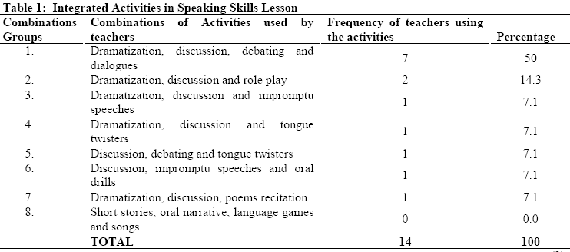
Integrated Activities in speaking Skills Lesson
Notes:
The author indicates that integrated classroom activities are used in speaking lesson by teachers, and compares among these activities to show which ones teachers like utilizing the best.
➔ -Quantitative: tests theory, establishes facts, shows relationships, predicts, or statistically describes

Slide 11
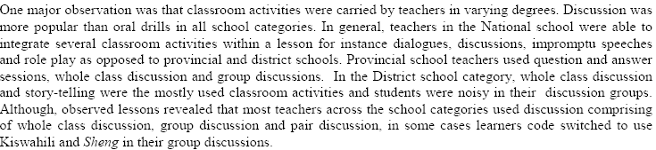
Comparing teachers’ activities in the National school with others’ in Provincial schools
Notes:
The author expressed findings clearlyTeachers in the National school were able to integrate several classroom activities within a lesson. While teachers in provincial schools used questions and answer sessions, whole class discussion and group discussions.

Slide 12
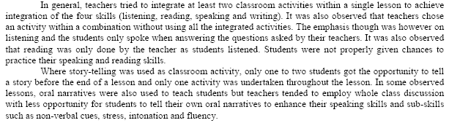

Slide 13
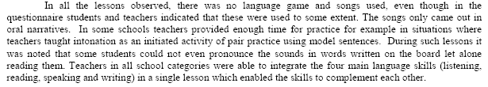
Teachers can able to integrate 4 skills (listening, reading, speaking and writing) in a single lesson.

Slide 14
Education Research
The application of the scientific method to study educational problems
The purpose of educational research is to find ways to improve student learning.
The goal is to explain, predict, and/or control educational phenomena
Methods – the various means by which data can be collected eg survey, questionnaire, interviews, observations
Data is analysed by quantitative methods. And qualitative method is applied in the observed lessons.

Slide 15
7. DISCUSSION
VARIATION ON USE OF CLASSROOM ACTIVITIES
MOTIVATION
TEACHERS’ ROLE
LEARNERS’ ROLE

Slide 16
Discussion
The author realized findings, then analyzed them to find out the causes and reasonable solutions for each.
Discussing some points such as variation on use of classroom activities, motivation, teachers’ role, learners’ role were reliable and relevant.
The other authors’ viewpoints which were reported before was used to consolidate the researcher’s ideas. Ex: Al-Hosin (2014); (Mwamba, 2005); (Alharbi 2015: 108), …

Slide 17
Through the observation: use of classroom was not similar: discussion > oral drills
Questionnaires |  | Observation
Teachers say: | students | Teachers: | Students:
Learner-centered methods |  | Lecture method Explanation | Low participation
Active students |  | Question and answer | passive
 |  | =>Teacher-centered methods

Slide 18
CAUSES |  | SOLUTIONS
Students | Teachers | Classroom activities | methodology | Classroom environment
Passive: using mother tongue in discussion | Wide curriculum: using teacher-centered methodology | Discussion, role play, speeches, dramatization, face-to-face communication independent work | Learner-centered Speaking-skill practice | Exciting, creative
Inadequate voc. , weak sentence building skills/ grammar structures | Repetition drills, memorization and lecture method | Pair work, group work, interviews | Employing various techniques | Challenging students, catering for diversity in students’ learning styles
Fear of making mistakes Cultural factors | Being unable to implement CLT | Teachers cognize learners’ cultural backgrounds so as to identify the most effective EFL speaking strategies and implement them according to learners’ need. =>facilitators Both teachers and students engage in learner –centered strategies.
=>keeping quiet Passive learners | =>boring stressful classroom

Slide 19
Other discussions
The author confirmed that motivation was an important factor which determined the rate at which learners undertake the activities.”
However, he did not give his own points about teachers’ role. To demonstrate his views, the author borrowed other researchers’ opinions.
Learners’ role was determined that “learners also lay an important role in speaking skills lesson. First, students should be ready to interact with the curriculum being provided. The learners then develop long-term self motivation and determination which will enable them to put more effort by participating actively in classroom activities and speaking in English outside the classroom.”
Causes, effects, and solutions were clear. Readers who are teachers can apply the solutions to their lessons today.

Slide 20
Conclusion
Reaffirm an argument:
First, all the classroom activities including discussion, dialogues, drama, oral narratives, songs, tongue twisters, debate, poem recitation, story-telling and role play were used during lessons but with different frequencies.
Two, code switching to use Kiswahili or Sheng by students was a problem in certain class group discussions which could hamper learning of the target language.Three, teachers prefer teaching classroom activities singly not integratively.
Reassert implications:
Discussion was used more across schools than oral drills. This could bring imbalance in the contribution of these classroom activities to the learner
Teachers should endeavour to teach using the target language (vocabulary, grammar, difficult concept which will encourage their learners to speak using the target language. The students should also be made to know the importance of attaining communicative competence in English language for instance job interviews, attainment of decent jobs and positive attitudes towards English language.
Teachers underrate the contribution of interaction with native speakers which is a key pillar in motivation of students.
Recommendations
First, teachers to discuss the importance of learning English language in national/international arena to motivate their learners to put a concerted effort in achieving communicative competence. Two, the curriculum design and teaching approaches should acknowledge cultural diversity and learning styles of learners in order to respond to the students’ needs. Three, teachers should speak using target language in the classroom frequently in order to expose students more to English language and to encourage them to use English in the classroom discourse (Tuan and Mai, 2015) . In addition, for learners to improve their speaking skills, they should speak using target language when undertaking classroom tasks and outside classroom, speak English at home with classmates, should be made to understand why it is important to acquire speaking skills, join speaking club
Suggested further research
i) The reasons for the low communicative competence of secondary school graduates. ii) It is not apparent in this study why teachers find it difficult to integrate several classroom activities to achieve the set objectives in speaking skills lessons.

Slide 21
Reference list: Using APA style
Notation:
At the beginning: A study done in Spain by Alonso (2014) found that teachers do not invite native speakers of English to interact with learners. A study done by Wu (2006) in Talley and Hui-ling (2014) indicated that EFL learners often lack exposure to native speaker models for their linguistic input because they have been exposed to non native models and are also non-native in host culture.
At the end: In Kenya English is taught as a second language, it has been given a high status than native languages by the Government due to its status as a national and international language (Chesang, 2005). It is used in all government communications, compulsory subject in educational system hence taught from standard one to university and a language for instruction from standard four to university (Ongondo, 2009; Sewe, 2009)
In-text Citation: Using APA style
-One author with one work: (Chesang, 2005)
-Two author with one work : (Kembo and Ogechi, 2009)
-….

Slide 22
Article review
1. Overview
The article is about finding out the classroom activities used by teachers to promote learners’ active participation in speaking skills lessons in eight secondary schools in Eldoret Municipality, Kenya.
The study was conducted mixed methods design and simple random sampling to select schools, students and English language teachers from National, Provincial and District schools in Kenya.
The data were collected by using questionnaires administered to teachers and students, direct observation during speaking skills lessons in Form three classrooms.
The results was variation in use of classroom activities.
According to the reading, the author has summarized the key issues including the strategy taken in the study. The main findings would also be presented in this abstract.
The author has shown that the importance of one attaining communicative competence in English language in Kenyan Education system cannot be overemphasized by presenting the past research. Some factors that influence learning of speaking skills.

Slide 23
The author want to accomplish that find out problem of poor spoken English language as a result of various reasons advanced by scholars such as: lack of assessment of speaking skills, students have no motivation to express themselves and others. And the specific objectives were to enhance learners such as: attentive listening for comprehension, correct inference, interpretation and appropriate response from spoken discourse, fluency and confidence in speaking in a variety of contexts, and others.
The next problem is English language syllabus should ensure that learners are equipped with comprehensive language usage and can express themselves in all situations.
The objective and method related are also mentioned. according to English language scholars, use of learner-centered classroom activities including group discussions, speeches, storytelling, drama, debates, poem recitation, songs, and tongue-twisters could alleviate the problem of low oral skills
This study is differ from works because it sought to establish classroom activities employed and how they are used by teachers to enhance learners’ active participation in secondary schools.
The author supported by evidence and organized logically and easy to follow in the introduction part.

Slide 24
2. A description of the methodology and evaluation
In order to find out the reasons for the lack of communicative and linguistic competence of secondary school students in Kenya, this paper focuses on how classroom activities are used in teaching speaking skills in English language by teachers to encourage the students’ learning.
To conduct research in this study, Eldora Municipality was selected because it encounters the low communicative competence of Form four school leavers that is similar to the other parts in Kenya.
The author chooses a National school as a purposive sampling while the Provincial and District secondary schools were chosen randomly. A total of 8 selected schools across Eldora Municipality, account for 30% of the sample population, are included in the sampling procedure. 30% of students are randomly selected from each school. Two English teachers who are purposely selected from each school.

Slide 25
Two data collection tools in this study were questionnaires and observation schedule. Tape recording was also used to make the observation process more accurate. Besides, the author used SPSS to analyze the collected data.
In my opinion, through this research methodology, the author identified the right subjects to find out what activities that teachers use in teaching speaking skills in English language to promote students learning.
Methods of data collection and analysis appropriate to the research purposes. Because this paper employed descriptive survey research design (Orodho and Kombo) so it has been done in a small scale. Further research required that is sampled and applied other methods such as focus group interview that is in such a way as to ensure the findings can be generalized to Kenya.

